Slide 1
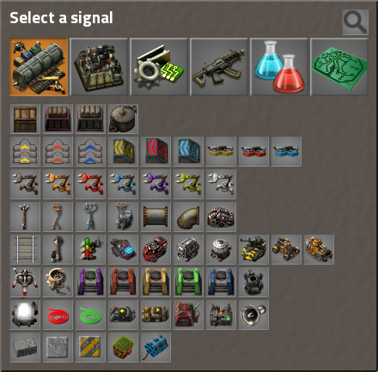
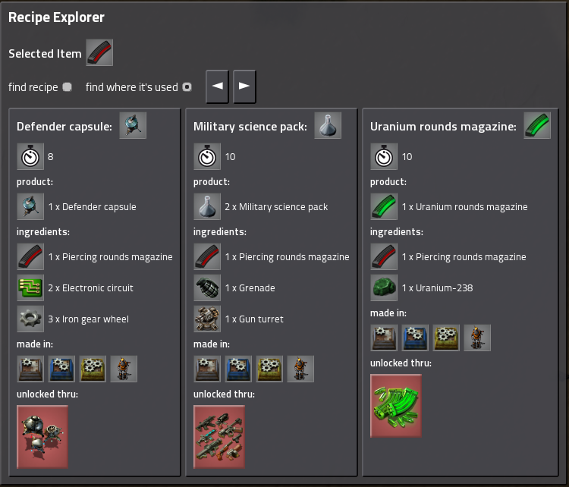
Recipe Explorer
Open and close with Ctrl + F
1
3
2
Select your item in a familiar interface.
Choose if you want find a recipe or find where the item is used.
Browsing thru your previous selected items.
Click on a product in the recipe to find out where it’s used.
Click on a ingredient in a recipe to find out how it’s made.
Find out where you can use the recipe and click on it to find the recipe for the processing machine.
Craft directly your items. (LMB = 1x, RMB = 5x)
Copy paste your recipe directly in your processing machine. (click and select area)
See directly if and which technology you need to unlock. Click on it and see the technology directly in the research tree (experimental feature).
8
4
5
6
7
9

